Slide 1
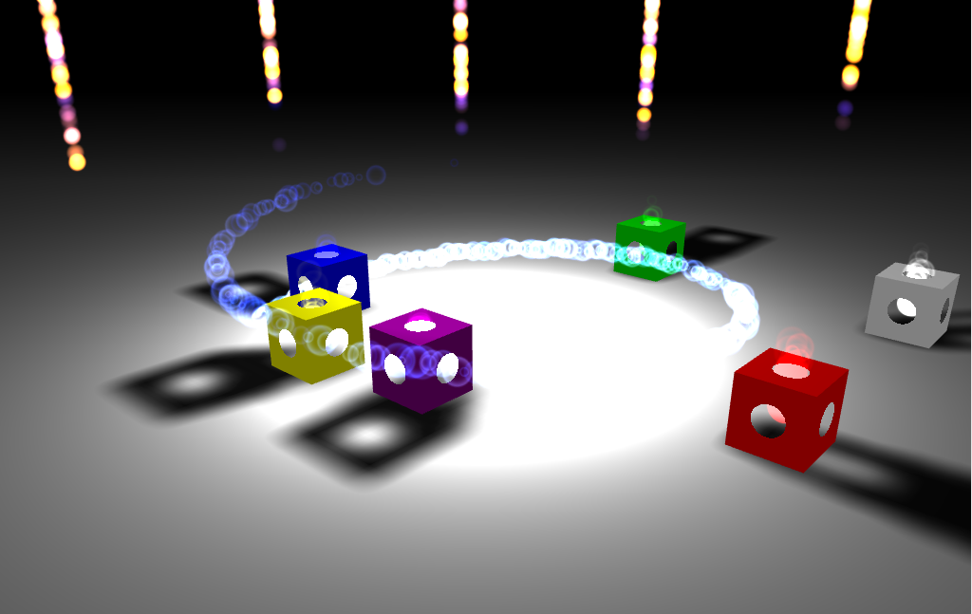
Create fun & immersive audio experiences with Web Audio
Notes:
Opening demo with Mansion

Slide 2
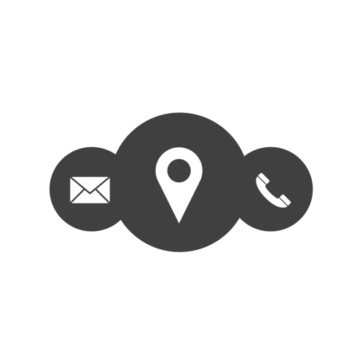
DAVIDROUSSET
Senior Program Manager
Microsoft Edge / Open Web Standards Developer Experience and Evangelism
davrous@microsoft.com - @davrous - http://aka.ms/davrous

Slide 3

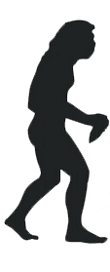

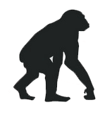
Most advanced audio stack for the web!
Web Audio API
<audio>
flash
<bgsound>
Inspired by: Learn Web Audio API

Slide 4
Web Audio in a nutshell
Provides a complete access to the sound stream
Works via an audio routing graph based on nodes
Offers a precise control over
Time
Filter
Gain
Spectrum analyzer
Convolvers
3D spatialization

Slide 5
Web Audio powerful & performant
Not running on UI Thread, little performance impact
Supported codecs are browser based: MP3 & WAV available everywhere
Scenarios: gaming, music web apps, speech synthesis, etc.

Slide 6
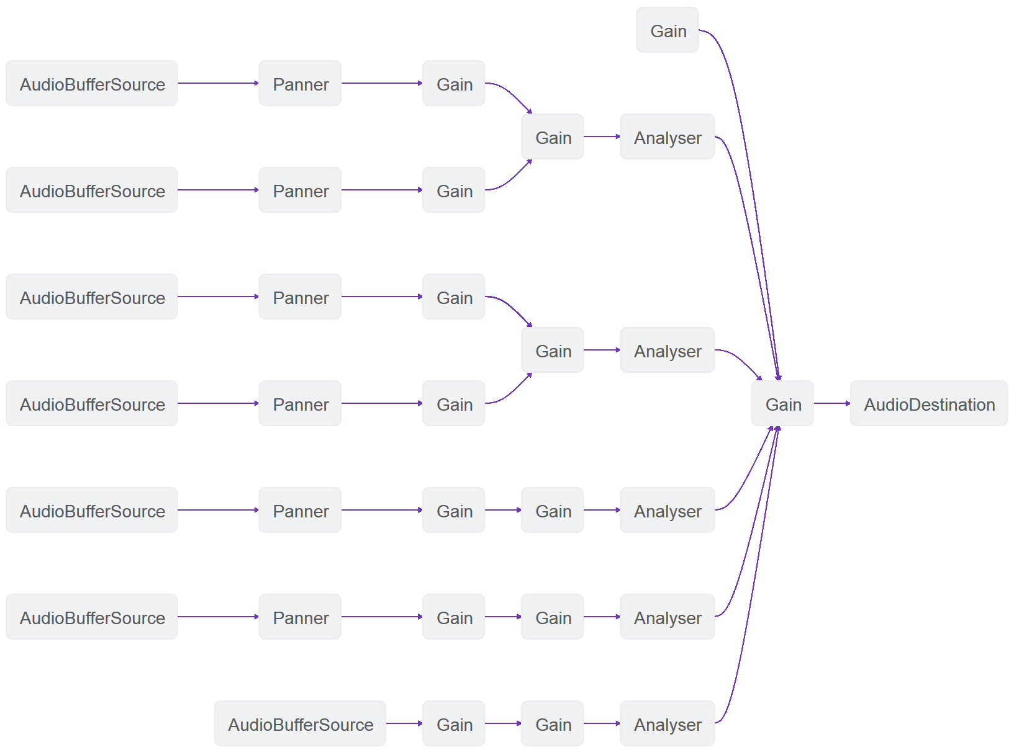
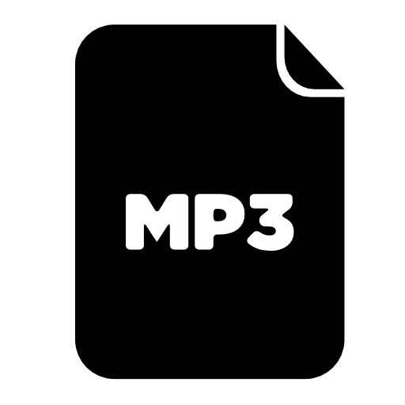

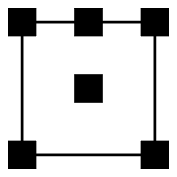
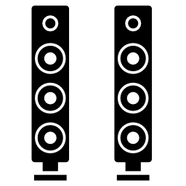




Audio routing graph explained

Slide 7
Creating the AudioContext
var canUseWebAudio = false;
try {
if (typeof AudioContext !== 'undefined') {
audioContext = new AudioContext();
canUseWebAudio = true;
} else if (typeof webkitAudioContext !== 'undefined') {
audioContext = new webkitAudioContext();
canUseWebAudio = true;
}
} catch (e) {
console.error("Web Audio: " + e.message);
}

Slide 8
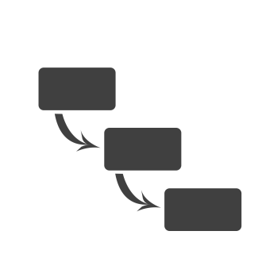
LET’S START FROM SCRATCH
Notes:
Simple sample to show how to load a sound using XHR / ArrayBuffer and play(0).

Slide 9
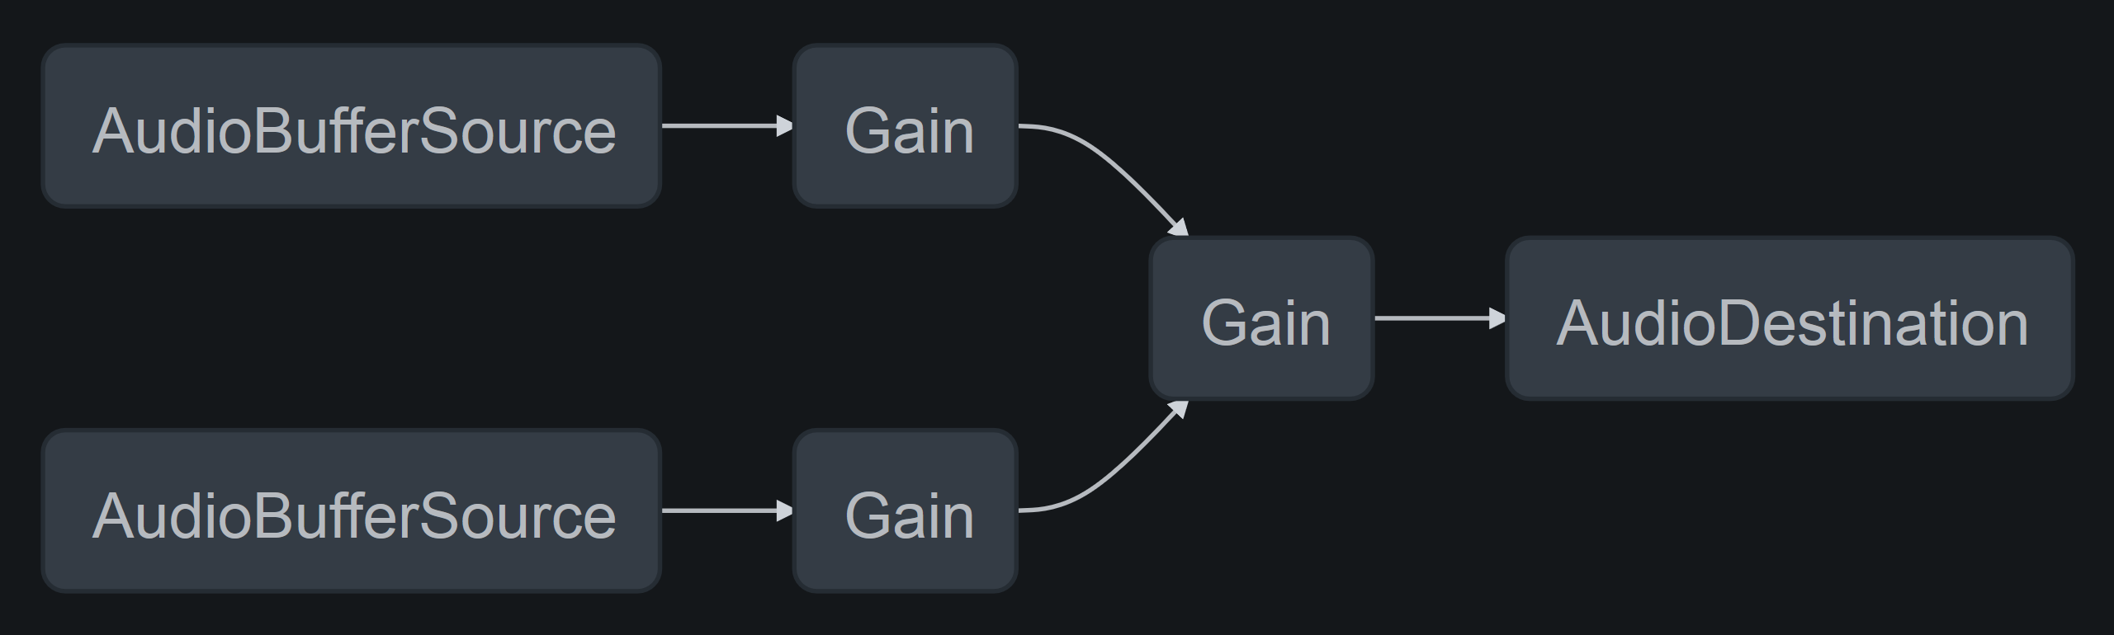
Mixing sounds in an easy way

Slide 10
SYNCHONIZING SOUNDS
Notes:
Playing 2 sounds being synchronized, a masterGain + each sound having it owns gain controlled by sliders

Slide 11
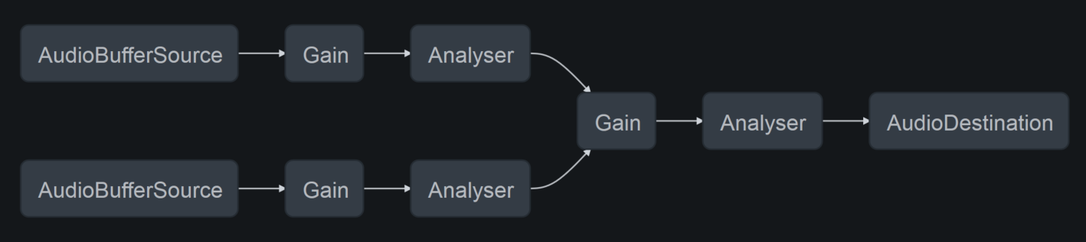
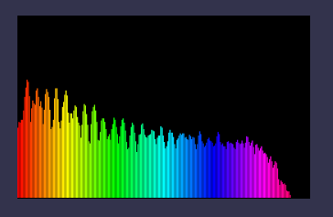
Analyzing sounds

Slide 12
ANALYZING SOUNDS
Notes:
Creating an audio graph with 2 sounds, 3 gain & 3 analyzer

Slide 13

3D Sounds
Based on OpenAL (Open Audio Library)
Most of the complexity being handled for you
Omnidirectional or directional sounds
Position
Direction
Velocity (Doppler effect)

Slide 14
3D SOUNDS
Notes:
http://www.babylonjs-playground.com/#2AH4YH

Slide 15
Web Audio: much more to discover!
Oscillators
Procedural sounds
Filters
Convolvers effects (reverb, cathedral, phone, etc.)
Dynamic Compression

Slide 16
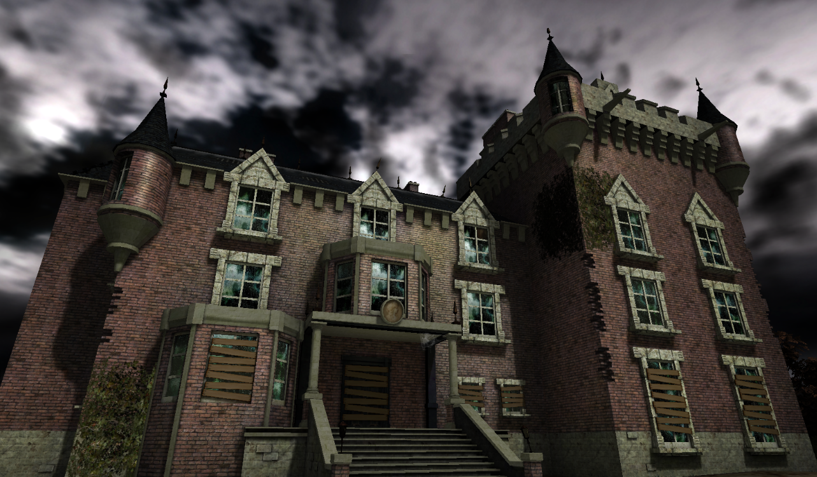
Babylon.js and Web Audio
Notes:
Opening demo with Mansion

Slide 17
How to use BABYLON.JS?
Open source project (Available on Github)
http://www.babylonjs.com
http://cdn.babylonjs.com/2-0/babylon.js
How to use it? Include one file and you’re ready to go!
To start Babylon.js, you’ve just need to create an engine object:
<script src="babylon.js"></script>
var engine = new BABYLON.Engine(canvas, true);

Slide 18
Babylon.js audio engine
Based on Web Audio
Ambient, omnidirectional & directional sounds
3D Sounds using linear attenuation by default
Handled by your code or our .babylon format file
Can be exported from 3DS Max (Blender & Unity to come)

Slide 19
BABYLONJS
EXPERIMENTS
Notes:
1 – 3D Sounds: http://www.babylonjs-playground.com/#2AH4YH + show babylon.js code+ adding a spectrum analyzer
2 – Attaching sound to a mesh: http://www.babylonjs-playground.com/index.html?23
3 – Directional sound: http://www.babylonjs-playground.com/#1BO0YS
4 – 3D Analyser: http://www.babylonjs-playground.com/#1YIXEO
5 – Mansion: http://www.babylonjs.com/index.html?MANSION
6 – Music Lounge being demonstrated via VS + explaining custom attenuation function
7 – Accessible Breakout Experiment

Slide 20
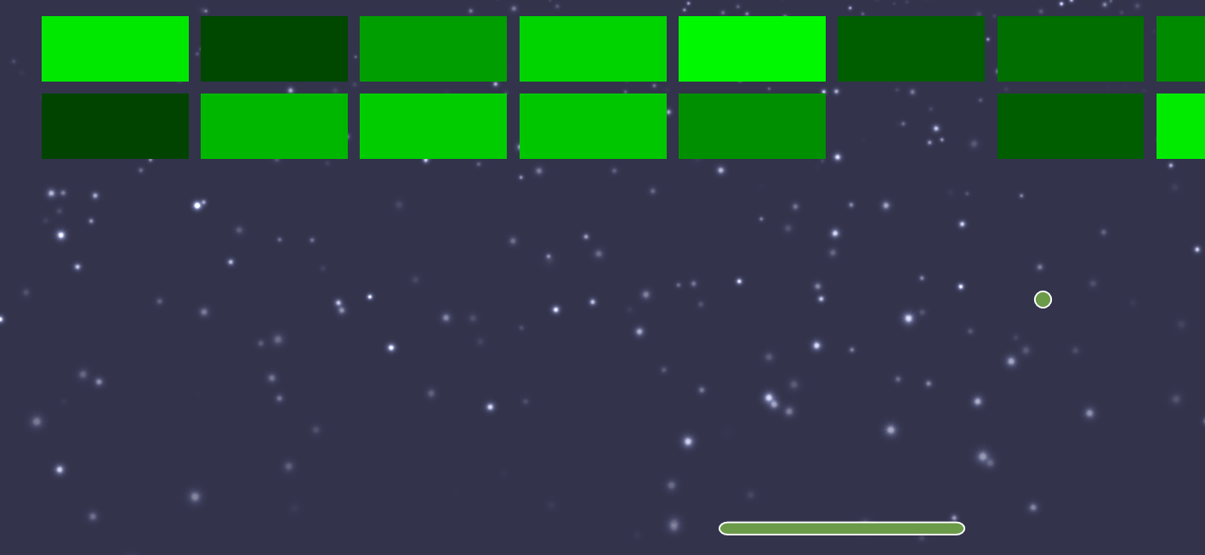
THANK YOU!

